Slide 1

DESIGN THINKING AND INNOVATION
Dr. D. Venkata Subbaiah
Professor, Computer Science & Engineering Department
Lakireddy Bali Reddy College of Engineering (A), Mylavaram

Slide 2
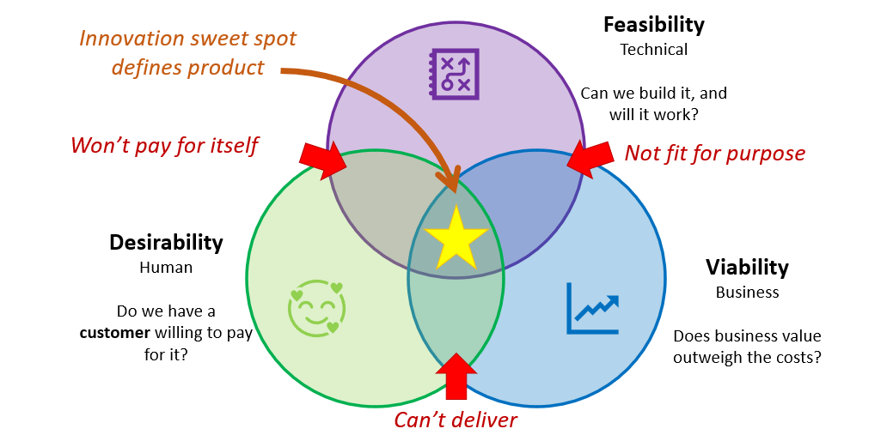
Elements of Design Thinking
Innovation/Outcome

Slide 3
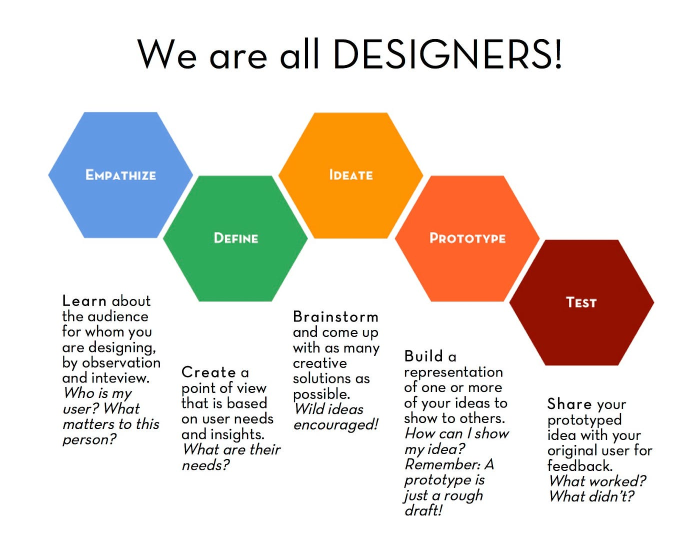
Elements of Design Thinking
INSIGHTS
NEEDS
CONCEPTS
MODELS
REFINE

Slide 4
Concept of Prototype
DEVELOPMENT OF MODELS
Prototype = the language of Design Thinking
Function = to communicate something about the idea
Purpose = to obtain feedback about the idea
A Prototype is a Message. It Communicates Something about your idea
A Prototype must speak for itself.
Types of Prototypes
Low Fidelity Prototypes (Simple paper based Rough prototype)
High Fidelity Prototypes (Advanced interactions and Transitions)

Slide 5
Concept of Testing: Steps Involved
Steps involved:
It is not to test the prototype, but to communicate your idea or Solution or Concept
You got an idea (Step 3 of DTI),
It is converted into prototype (Step 4)
You are testing your idea or design
(Step 5)
Stages involved
3 Stages
  Get the Cheap Information
  Technical Feasibility in Lab
  Promotion

Slide 6
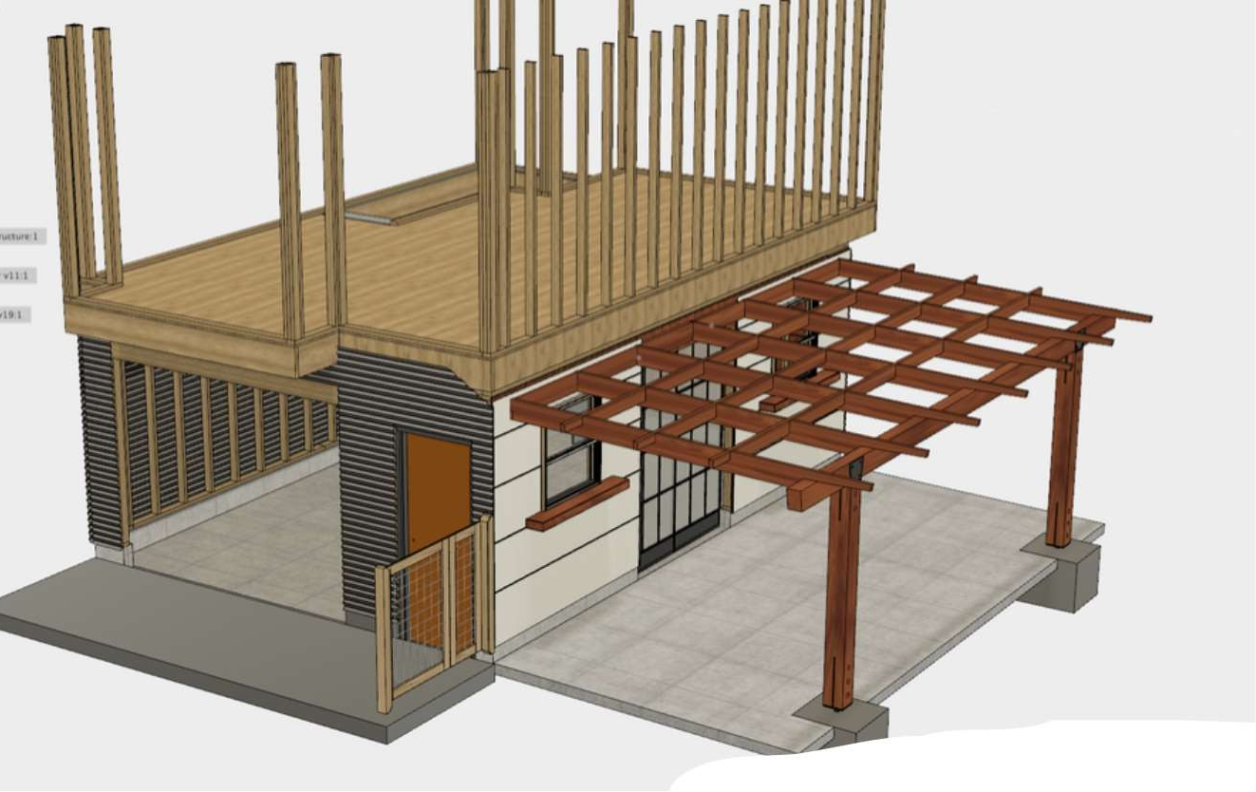
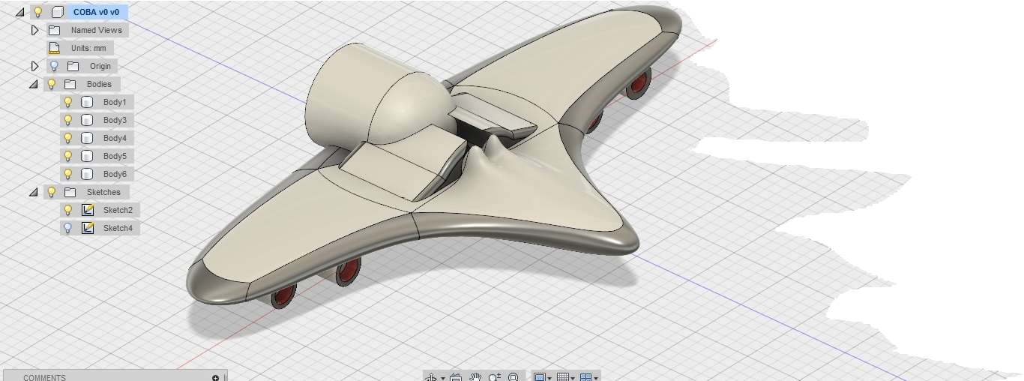
Concept of Testing: Steps Involved
Develop 3D Models and test their functionality

Slide 7
Concept of Testing: Steps Involved
STEP-1
Show a prototype to a user
Observe how the user reacts
Ask questions and prompt the user to speak
Things not to do during Testing
Talking and not Listening
Blaming Customers for not understanding
Answering Customer questions
Inventing on the spot
Asking Closed Questions
SHOW – OBSERVE - ASK

Slide 8

Concept of Testing: Stages in Testing Process
Tests with Users
Tests in laboratory
BENEFITS
LOOK & FEEL
USER EXPERIENCE
PROMOTION
FEATURES
Cheap
Cost of Experiment
Expensive

Slide 9
Concept of Testing: How to test your Prototype
First Glance Questions
What do you think this tool/ website is for?
What do you think you can do on this website/ in this app?
When would you use this?
Who do you think this tool is for?
Is there anything this tool resembles? If yes, what?
What, if anything, doesn’t make sense here?

Slide 10
Concept of Testing: How to test your Prototype
Task-specific by use questions
How did you recognize that the product was on sale? (E-commerce and retail)
What information about shipping was missing, if any? (E-commerce and retail)
What were the accepted payments methods? (E-commerce and retail/Software as a service (SaaS)
How did you know the plan you picked was the right one for you? (SaaS)
Do you think booking a flight on this website was easier or more difficult than on other websites you have used in the past? (Travel)
Did sending money via this app feel safe? (Banking/FinTech)
Do you think data gathered by this app is reliable? (Internet)

Slide 11
Concept of Testing: How to test your Prototype
Assess Usability Questions
Was there anything that surprised you? If yes, what?
Was there anything you expected to find that was not there?
What was difficult or strange about this task, if anything?
What was easy about this task?
Did you find everything you were looking for?
Was there anything that didn’t look the way you expected? If so, what was it?
What was missing, if anything?
What was unnecessary, if anything?
Was anything out of place? If so, what was it?
If you had a magic wand, what would you change about this experience/task?
How would you rate the difficulty level of this task?
Did it take you more or less time than you expected to complete this task?
Would you normally spend this amount of time on doing this?

Slide 12

Concept of Testing: How to test your Prototype - Activity
Activity
Make the students to form 2 groups
one group acting as design thinkers
others acting as users/ customers.
Design thinkers display their prototype created and gets the feedback from the users by asking the above listed questions.
If your prototype calls for any other inquiry not covered by the stipulated questions, add them
If your prototype doesn’t require it, omit the question

Slide 13


